Slide 1


How Reading Affects Your Brain & Behavior
Patricia
Greenfield
Dept of Psychology, UCLA
Children’s Digital Media Center
@Los Angeles
Goldie Salimkhan, 2011
Scanners, San Francisco
October 23, 2011

Slide 2
Reading as a medium has both benefits and costs
For both brain and behavior
Will start with brain

Slide 3
How learning to read changes cortical networks
(Dehaene et al., 2010, Science)

Slide 4

How learning to read changes cortical networks
(Dehaene et al., 2010, Science)
fMRI study
fMRI = functional Magnetic Resonance Imaging
Groups
Notes:
Read first two lines of slide: fMRI: Can see brain response (actually image blood flow, which indexes brain activity) during actual activities. MRI without the f just looks at brain structure.
Groups. Explain each one. L = literate, learned as children in school. B = Brazil. P = Portugal EX = exilliterates (prefer adult literates). There was a group from Brazil and a group from Portugal.
This was the order of actual reading competence, as tested in the study. Tests of letter id, word (and nonsense-word) reading, sentence reading
LB2 group were matched to the illiterates in ses, but had been to school as children.

Slide 5
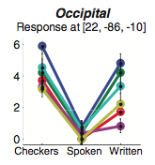
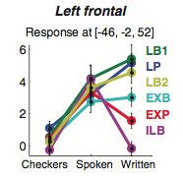
How learning to read changes cortical networks
(Dehaene et al., 2010, Science)
Left frontal cortex = Area for
producing sentences
Groups
Notes:
Explain graph. The vertical axis is a scale of rain activation at certain sites in the left frontal cortex. Left frontal cortex does not respond to visual stimuli like moving checkerboards. It is activated by spoken language; in other words it is responsible for processing spoken language. If damaged, people have problems with spoken language as in certain kinds of aphasia.
Left frontal cortex is a key area for language, especially speech planning or complex speech. No group differences in response to spoken sentences. But look at how the groups differ in response to written sentences (the right-hand points). The left frontal cortex of the three childhood literacy groups are the most activated by seeing written sentences (green and blue points). Then the groups who acquired literacy in adulthood (turquoise and red points); finally, with basically no activation, the illiterates.
So, results with left frontal cortex show that higher levels of reading skill recruit and augment activity in speech areas of the brain.

Slide 6
How learning to read changes cortical networks
(Dehaene et al., 2010, Science)
Occipital cortex = Area for
responding to visual stimuli
Groups
Notes:
Explain graph. The vertical axis is a scale of rain activation at certain sites in the occipital cortex (brain region for responding to visual stimuli) For the occipital or visual cortex, the pattern is reversed from the last graph in neural response to checkers and spoken sentences: Checkers activate the occipital region of all groups, but spoken sentences do not. However, written sentences activate the visual cortex the most for childhood literates in both countries. Brazilian exilliterates and low SES literates are next. Least activation by written sentences: Illiterates.
This graph shows that reading also recruits visual cortex and produces more visual response the higher the level of reading skill. The results also suggest a connection to SES because Exillliterates in Brazil (turquoise point on right) show more activation than do low SES childhood literates (olive green point on right).

Slide 7
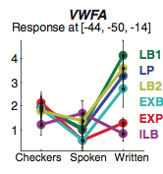
How learning to read changes cortical networks
(Dehaene et al., 2010, Science)
Visual Word Form Area = Area of cortex for reading words
Groups
Notes:
Explain graph. VWFA: specialized reading area. The vertical axis is a scale of rain activation at certain sites in the Visual Word Form Area. See that in no group does this area respond either to checkerboard pattern or to spoken sentences. In all the literate groups, the VWFA responds to writtten sentences to at least some degree. Except the illiterate group (purple dot on the right). Note that the three childhood literacy groups (schooled) show the most response.
This graph shows that reading skill recruits and enhances activity in the reading area of the brain (Visual Word Form Area)

Slide 8
Possible neural cost of recruiting the Visual Word Form Area (VWFA) for reading
VWFA also plays important role in responding to faces and other visual stimuli. (started long before reading evolved)
Competition hypothesis: Decreased neural response to other visual stimuli with increase in reading performance
In fact, significant decrease in neural response to faces in VWFA and several other brain areas as reading skill increased; this decrease in neural response to faces was larger than the response to any other visual stimulus.
Early schooling/early literacy (vs. adult-acquired literacy) had big effect on reducing neural response to faces in the VWFA.
.

Slide 9
But………………
these losses were counterbalanced by increased neural responding to faces in some other areas of the brain, as well as a shift from left to right hemisphere in the visual cortex.
The net result was that literates had more brain regions that were more differentiated by function.
Nonetheless, the authors of the study say that they will explore in future research “the intriguing possibility that our face perception abilities suffer in proportion to our reading skills.”

Slide 10
Summary of Findings on Effects of Reading on Brain Function (Dehaene et al., 2010, Nature)
Results with left frontal cortex, which is a key area for language, especially speech planning or complex speech, show that reading recruits and augments activity in speech areas of the brain.
Results with the occipital cortex, which is specialized for visual stimuli, show that reading also recruits visual cortex and produces more visual response the higher the level of reading skill.
Results with the Visual Word Form Area (VWFA) show that reading skill enhances activity in the reading area of the brain, competing successfully with its face processing function to reduce the VWFA’s neural response to faces.
However, other brain areas increase their response to faces with increasing levels of reading skill.
Hence it remains to be seen from future research whether reading has an overall negative effect on the response to human faces.

Slide 11
Effects of reading on brain anatomy (Carreiras et al., 2009)
A study comparing late-literates with matched set of illiterates in Colombia
Guerillas reintegrating into Colombian society
First opportunity to learn to read in their late 20s
Another natural experiment
MRI scans
Findings: late-literates had more grey matter in five brain regions activated in fMRI studies of reading
Notes:
Read slide
Grey matter definition: Grey matter are the cell bodies and their connecting elements responsible for functions like speaking, visual perception, and reading: the anatomical basis for the brain fumctions I have been talking about.

Slide 12
Implications
Reading sculpts human brain function
But so does every experience
Another way of putting this: Our brains adapt to new behavioral functions through learning processes – this is the hallmark of the human species.
These learning processes - including learning to read – leave traces in brain anatomy, which supports brain function.
The real question about functional changes brought about by reading is whether there is a cost to other functions – particularly the important social function of responding to the human face.
Because reading also leads to enhancement of function in other neural areas in response to faces, i.e., brain differentiation, the answer to this question remains for future research.
But there is also a question as to whether increased brain differentiation makes psychological integration more difficult for us.

Slide 13
Effects of reading on behavior
Cognitive processes
Social behavior

Slide 14
Effects of reading on behavior
Cognitive processes
Social behavior

Slide 15
Reading is associated with reflection. It stimulates creativity. It enhances critical thinking
How do we know this?
Study of reflection in first grade students
Analysis of what happens when a book is made into a film
Study of creativity in 7th graders
Study of critical thinking in freshman college students

Slide 16
Reading is associated with reflection. It stimulates creativity. It enhances critical thinking
How do we know this?
Study of reflection in first grade students
Analysis of what happens when a book is made into a film
Study of creativity in 7th graders
Study of critical thinking in freshman college students

Slide 17
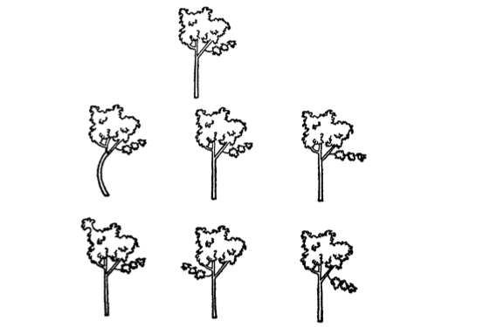
Test of impulsivity/reflection
Impulsive = fast, lots of errors
Reflective = slow, few errors
Task: Find the shape that matches
the top tree.
Finding: Better readers in first grade were more reflective.
(Kagan, 1965)
Notes:
Answer: top row, middle tree.
Reflective: operationally defined here as thinking about alternatives.

Slide 18
Reading is associated with reflection. It stimulates creativity. It enhances critical thinking
How do we know this?
Study of reflection in first grade students
Analysis of what happens when a book is made into a film
Study of creativity in 7th graders
Study of critical thinking in freshman college students

Slide 19
Book: Being There by Jerzy Kosinski
Compared with the movie Being There
Implications for the individual psyche
Notes:
An important part of the book is made up f the thoughts of the main character Chance. The film version uses the TV screen to show what Chance is watching, but is unable to portray the subtleties of what he is thinking. Film is forced to portray internal thought through external action.
Implications: Books are unique in providing role models of internal thought. This may be one way in which they foster reflective thought. Another reason is that the book is not a real-time medium. It does not pace you or rush you. Unlike tv or video games, you can go at your own pace.
What other cognitive effects and what about other age groups?

Slide 20
Reading is associated with reflection. It stimulates creativity. It enhances critical thinking
How do we know this?
Study of reflection in first grade students
Analysis of what happens when a book is made into a film
Study of creativity in 7th graders
Study of critical thinking in freshman college students

Slide 21
Imagination study (Meline, 1976)
Seventh graders divided into 2 groups
One group saw educational films about four social problems (video group)
One group read about the same social problems (print group)
One problem was about developing new ideas for recycling waste materials
Film and print materials presented sample solutions – e.g., film showed used tires being tossed into a giant incinerator and burned to create power in a British factory. The print materials presented the film narration of this happening.

Slide 22
Afterwards the children were told that what they had seen (read) was one approach to the particular problem (e.g., the recycling problem)
They were then asked to think of and write down “the best, most original idea you can think of.”

Slide 23
Definition of creativity
Answers were scored for two features of creativity
Freedom from the stimulus
Responses go off in directions not indicated by the question
Use facts and concepts not present in the given information
Transformation
Create new forms, new terms, new categories
Appropriate to the problem
Stimulate more ideas, more thinking, have heuristic value.
Notes:
After read slide (if time): Three judges: 2/3 had to agree for scoring of either to take place. Strong agreement among the judges

Slide 24
Results
Possible solutions developed by the print group showed more freedom from the stimulus than those developed by the video group.
Possible solutions developed by the print group showed the quality of transformation more frequently than those developed by the print group.

Slide 25
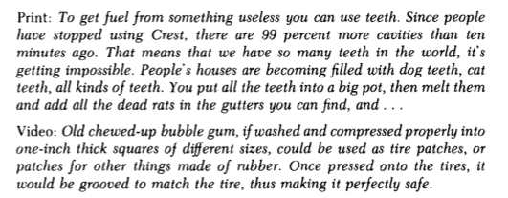
Freedom from stimulus: print (7th grade)
Notes:
Here is an example of how one 7th grader demonstrated freedom from the stimulus in response to print.
While another did not in response to video.

Slide 26

Transformation: Print vs. video (7th grade)
Notes:
Here is an example of how one 7th grader demonstrated transformation in response to print.
While another did not in response to video.

Slide 27
Conclusion
Given the same content, the print medium stimulates creativity, defined in this way, more than the video medium.
However, this is a classical definition of creativity, and new media may be stimulating new types of creativity: a postmodern, collage type of creativity.

Slide 28
Reading is associated with reflection. It stimulates creativity. It enhances critical thinking
How do we know this?
Study of reflection in first grade students
Analysis of what happens when a book is made into a film
Study of imagination in 7th graders
Study of critical thinking in freshman college students

Slide 29
Longitudinal study of development of critical thinking during the first year of college

Slide 30

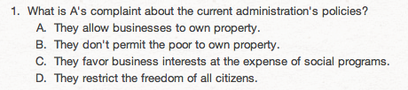
Test of critical thinking
Notes:
Part of a sample passage, sample question. From a standardized test, the Collegiate Assessment of Academic Proficiency.

Slide 31
Test of critical thinking
Notes:
Here is the answer

Slide 32
Results
Critical thinking –Number of non-assigned books read during freshman year was positively related to improvement in critical thinking skills during the year.
(Terenzini et al., 1995)
Notes:
Nonassigned books = reading for pleasure
Implications for society: Political life. Public has gone from critical assessment of issues to external image as we have moved from newspaper to tv as major source of political news and analysis. In fact, the kind of analysis presented in newspapers is not found at all on TV.

Slide 33
Effects of reading on behavior
Cognitive processes
Social behavior

Slide 34
Social effect of literacy and reading
Wober study in Nigeria in 1960s. Workers in a company could choose between:
1. suburban housing development with yards in a quiet residential environment
or
2. living in traditional crowded, noisy, sociable urban environment with lots of street life
When workers chose the former over the latter, it was often because they wanted to be alone in peace and quiet to read!
Literacy and formal schooling were just becoming widespread in Nigeria at that time

Slide 35
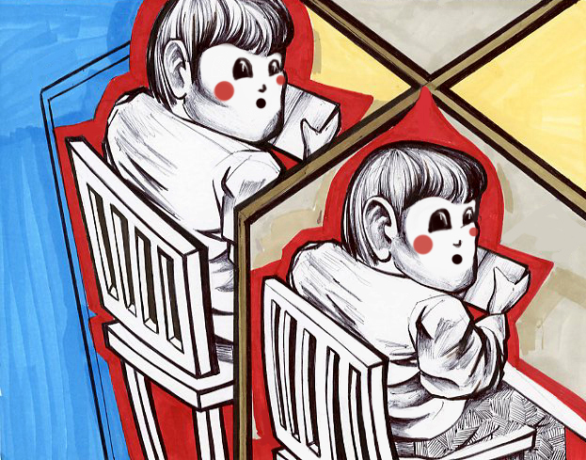
So literacy was the first technology to reduce face-to-face interaction.
Goldie Salimkhan, 2011
Notes:
Now we have social networking and email, etc. that continue this trend.

Slide 36
Conclusions
Brain
On the neural level, the brain has adapted to reading by
augmenting activity in the neural areas dedicated to speech
recruiting areas of the visual cortex to work in the service of reading,
enhancing activity in a part of the brain that has come to be known as the Visual Word Form Area
Behavior
Reading makes our cognitive processes
more reflective,
more critical
more creative in the classical sense.
In terms of social behavior, reading was the first medium to reduce social interaction. But it was not the last!

Slide 37
The End!
Let’s talk!

